Slide 1
Swiggy Application

Slide 2
Synopsis
The main objective of the Project on Online Food Ordering System is to manage the details of Food, Item Category, Shopping Cart, Customer, Order.
It manages all the information about Food, Delivery Address, Order, Food.
This sites consists a various types of foods.
It allows users to make payment through various modes like upi and using card.

Slide 3
Features
Register and login via email
user can update/delete his/her profile
user is able to place food
payment method
Admin can add/update/delete food.
Admin can add/update/delete restaurants.

Slide 4
User Stories
implement Login and Signup Api :- user can login via email
implement jwt :- for authorization purpose
implement swagger
implement MongoDb
payment api:- implement payment integration for online payment
food & restaurants api :- Add/Get/Update/Delete
User api :- registration/login/update/delete profile

Slide 5
Software Requirements
Spring Tool Suite
MongoDbCompass
Postman
Git
Junit
Mockito

Slide 6
Hardware Requirements
Processor: - 1.2GHz and above
Hard Disk: - more than 20GB
RAM: - Minimum 1 GB

Slide 7
Model Class
User
Food
Restaurants
Cart
Orders
Payment

Slide 8
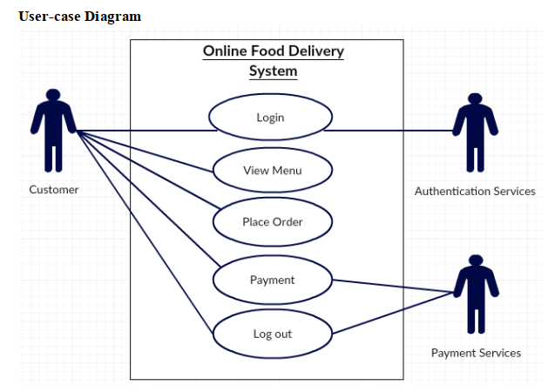
Use Case Diagram

Slide 9
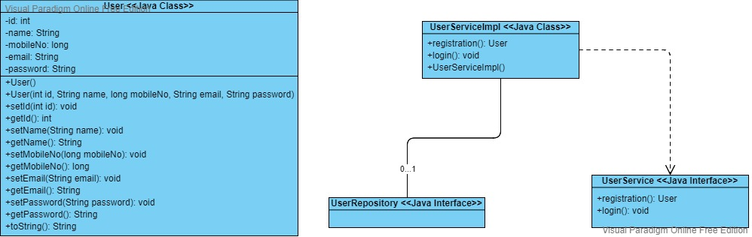
Class Diagram for User

Slide 10
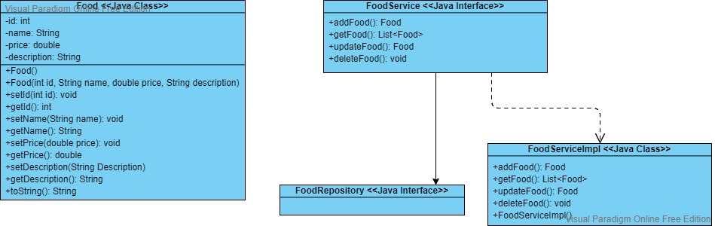
Class Diagram for Food

Slide 11
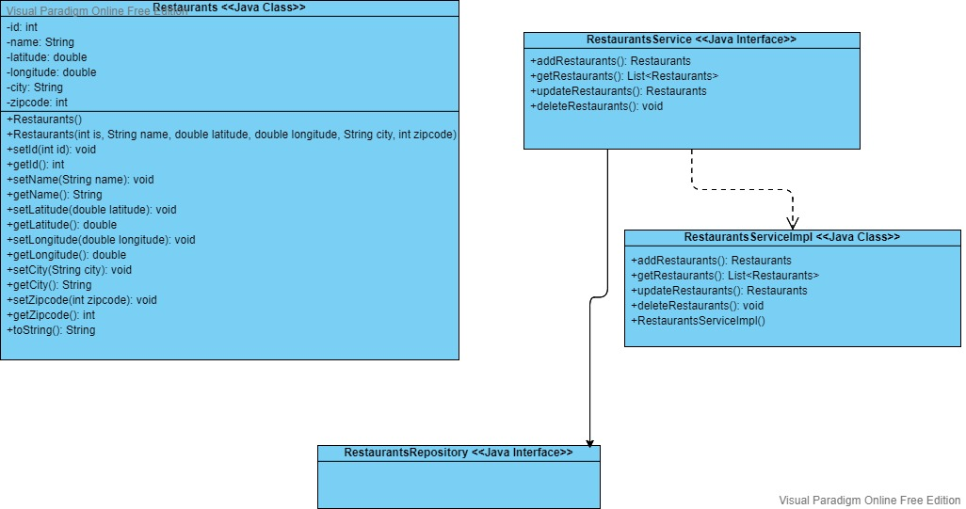
Class Diagram for Restaurants

